Slide 1
AfriLearning

Slide 2
Problem
Students in remote areas of Africa can’t afford attending classes due to high cost of education, and the proximity from their residence to the educational centres make it entirely difficult to access any form of education thereby resulting in increase Illiteracy Rate.

Slide 3
Solution
The quest of accessible free education have long been a major topic, with AfriLearning we plan to simplify students education experience by developing a online application where teachers and student can interact and perform educational task.
Our main focus is to alleviate the literacy problem and improve standard of living through education.

Slide 4

Target Markets
AfriLearning is developed primarily for all levels of student inclusive.
The platform is also tailored made for teachers to interact effectively with students.
Proprietor/proprietress, School principles, Dean of faculties are some of those will use the Admin panel to manage the educational process.

Slide 5
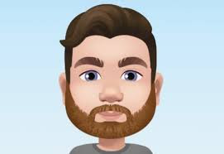


Meet our Team
CEO
CFO
COO
Enoch King
Software Product Manager
Matthew Freeman
System Architect
Alexander Cumming
Head of Marketing

Slide 6
Thanks for your Attention!!

